Slide 1
VARDAAN LEARNING INSTITUTE
CHAPTER 10: ELECTROMAGNETISM
Comprehensive Master Lecture & Colorful Visual Notes

Slide 2
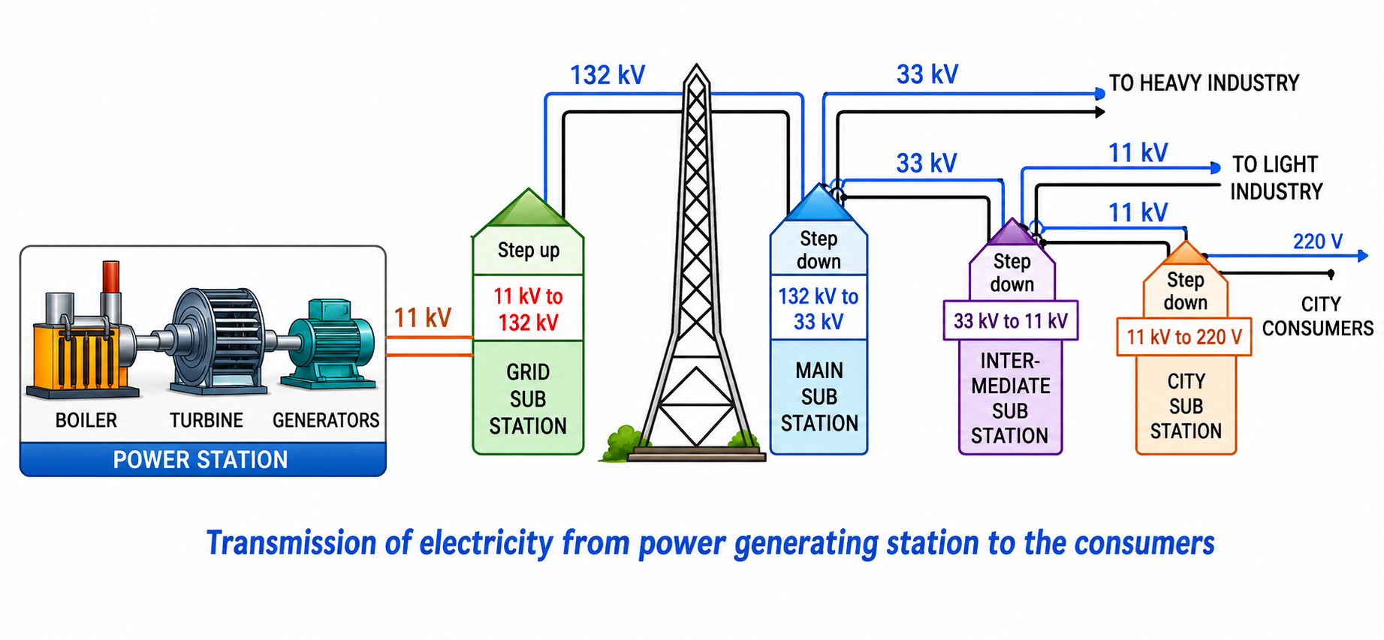
1. Oersted's Historic Experiment
â€¢ Discovered by Hans Christian Oersted in 1820.
â€¢ He observed that an electric current flowing in a straight conductor produces a magnetic field around it.
â€¢ When a compass needle is placed near a current-carrying wire, it deflects.
â€¢ SNOW Rule: If current flows from South to North in a wire held Over a magnetic needle, the North pole of the needle deflects towards West.
â€¢ The deflection reverses if the current direction is reversed.
Powered by Vardaan Comet â€¢ Vardaan Learning Institute

Slide 3
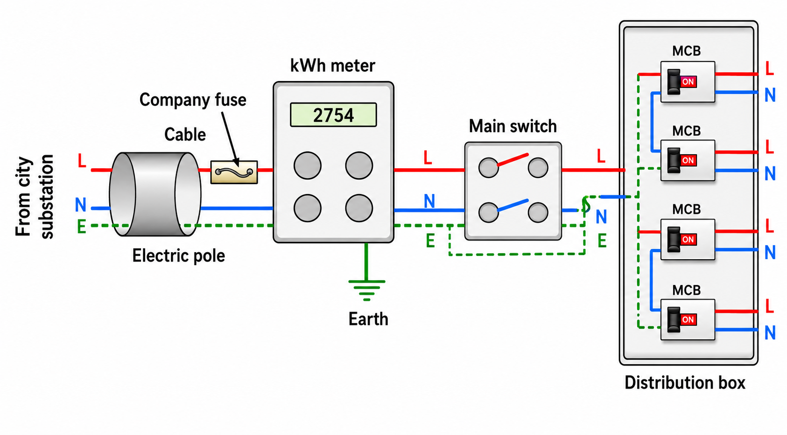
2. Magnetic Field Lines & Properties
â€¢ A magnetic field is the space around a magnet where its influence can be felt.
â€¢ Property 1: Field lines are continuous closed loops (exit North, enter South).
â€¢ Property 2: The tangent to a field line gives the direction of the magnetic field.
â€¢ Property 3: Two magnetic field lines NEVER intersect (it would mean two directions at one point).
â€¢ Property 4: Crowded lines indicate a strong magnetic field.
â€¢ Neutral Points: Points where the magnetic field of the wire exactly cancels the horizontal component of Earth's magnetic field.
Powered by Vardaan Comet â€¢ Vardaan Learning Institute

Slide 4
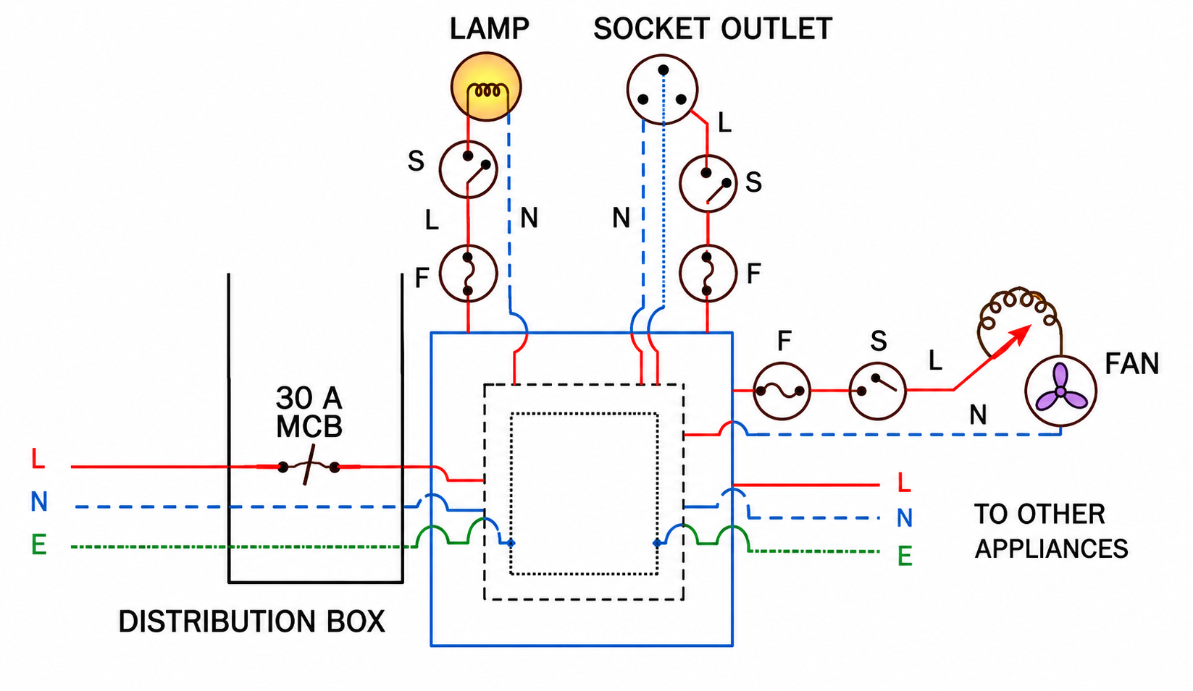
3. Straight Conductor & Thumb Rule
â€¢ The magnetic field around a straight current-carrying wire consists of concentric circular loops.
â€¢ Strength of field (B) is directly proportional to the current (I).
â€¢ Strength of field (B) is inversely proportional to the distance (r) from the wire.
â€¢ Right-Hand Thumb Rule: Hold the wire in your right hand with the thumb pointing in the direction of current.
â€¢ Your curled fingers will point in the direction of the magnetic field lines.
Powered by Vardaan Comet â€¢ Vardaan Learning Institute

Slide 5
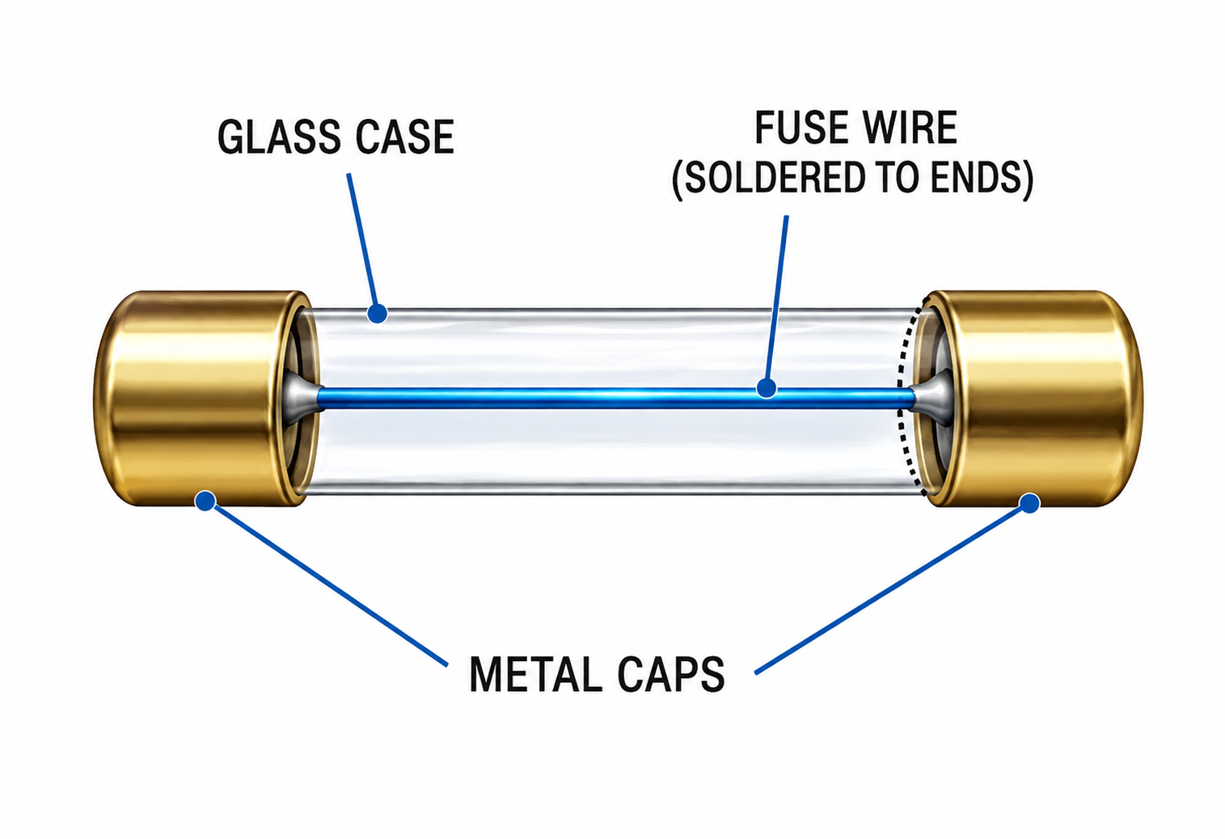
4. Circular Loop & Solenoid
â€¢ Circular Loop: Current in a loop creates a magnetic field straight at the center.
â€¢ Clock Face Rule: Clockwise current acts as a South (S) pole; Anticlockwise current acts as a North (N) pole.
â€¢ Solenoid: A long cylindrical coil of insulated copper wire.
â€¢ It behaves exactly like a bar magnet. The field inside is uniform, straight, and parallel.
â€¢ To increase solenoid strength: Increase current (I), increase number of turns per unit length (n), or insert a soft iron core.
Powered by Vardaan Comet â€¢ Vardaan Learning Institute

Slide 6
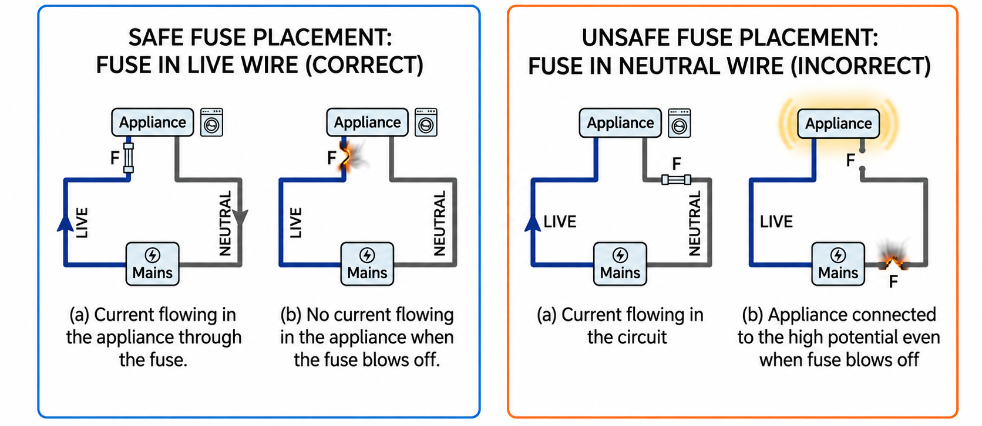
5. Electromagnets & The Electric Bell
â€¢ Electromagnet: A temporary magnet made by winding wire on a soft iron core.
â€¢ Soft Iron vs Steel: Soft iron loses magnetism instantly (low retentivity) and is used for electromagnets.
â€¢ The U-shaped horseshoe core is used because it brings the North and South poles closer, making the magnetic field incredibly strong.
â€¢ Electric Bell: Uses an electromagnet to attract a soft iron armature. This breaks the circuit in a continuous 'make-and-break' cycle, causing the hammer to strike the gong repeatedly.
Powered by Vardaan Comet â€¢ Vardaan Learning Institute

Slide 7
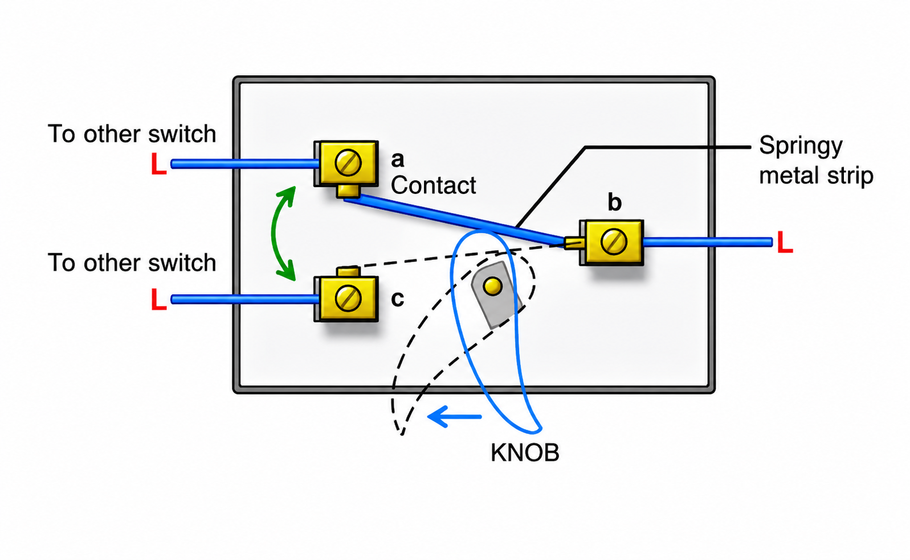
6. Lorentz Force & DC Motor
â€¢ Lorentz Force: A current-carrying conductor in a magnetic field experiences a force. F = I Ã— L Ã— B Ã— sin(Î¸).
â€¢ Fleming's Left-Hand Rule: Stretch thumb, forefinger, and middle finger at 90 degrees.
â€¢ Forefinger = Magnetic Field, Middle Finger = Current, Thumb = Force/Motion.
â€¢ DC Motor: Converts electrical energy into mechanical energy.
â€¢ Split-Ring Commutator: Reverses the current in the armature every half rotation, ensuring continuous rotation in the same direction.
Powered by Vardaan Comet â€¢ Vardaan Learning Institute

Slide 8
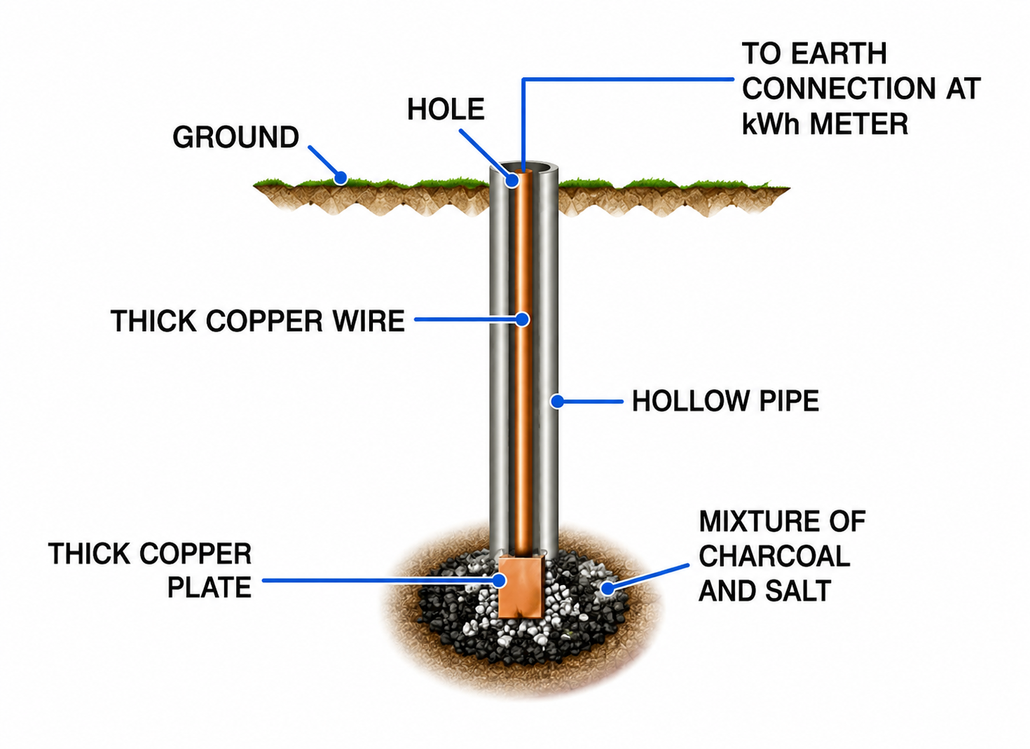
7. Electromagnetic Induction (EMI)
â€¢ EMI is the phenomenon where a changing magnetic flux induces an electromotive force (EMF) in a coil.
â€¢ Faraday's Law: The induced EMF is directly proportional to the rate of change of magnetic flux.
â€¢ Lenz's Law: The direction of the induced current is such that it opposes the cause producing it.
â€¢ This is in accordance with the Law of Conservation of Energy.
Powered by Vardaan Comet â€¢ Vardaan Learning Institute

Slide 9
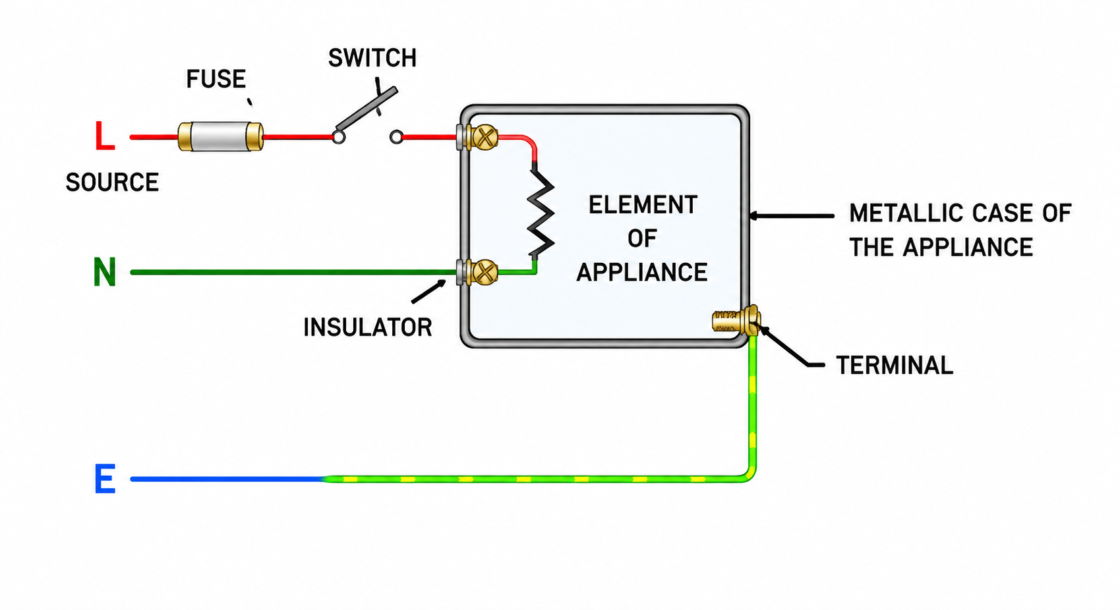
8. AC Generator & Alternator
â€¢ AC Generator: Converts mechanical energy into electrical energy using EMI.
â€¢ Unlike a DC motor, it uses continuous Slip Rings (R1 and R2).
â€¢ It outputs an Alternating Current that reverses direction periodically.
â€¢ In India, the household AC supply is 220V at 50 Hz.
â€¢ 50 Hz means the current changes direction 100 times every second.
Powered by Vardaan Comet â€¢ Vardaan Learning Institute

Slide 10
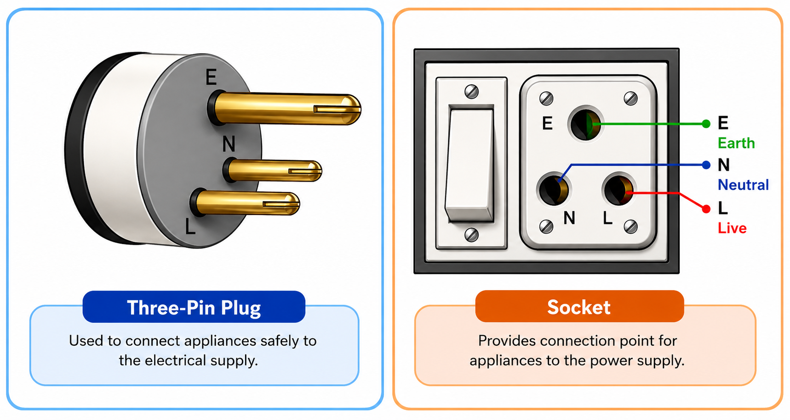
9. Transformers
â€¢ Principle: Based on Mutual Induction between primary and secondary coils.
â€¢ Step-Up Transformer: Increases voltage (Vs > Vp). It has more secondary turns (Ns > Np) and uses thick primary wire.
â€¢ Step-Down Transformer: Decreases voltage (Vs < Vp). It has fewer secondary turns (Ns < Np) and uses thick secondary wire.
â€¢ The core is laminated to prevent energy loss due to eddy currents.
Powered by Vardaan Comet â€¢ Vardaan Learning Institute

